Slide 1
Market Data Business Use Cases &
Time Series Forecasting
http://www.free-powerpoint-templates-design.com

Slide 2
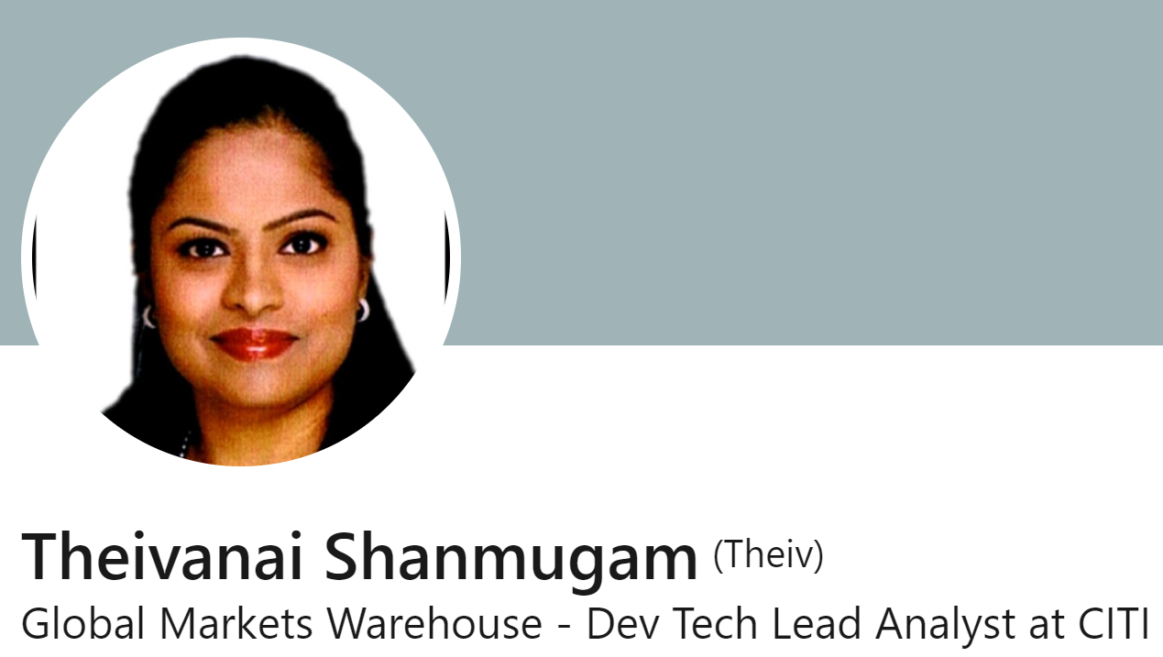
About Theiv
Tech Lead Analyst , ICG-IT
I lead the Olympus - Market Data,
Product Engagement model.
Work with the team to future proof the product that we deliver to ensure we are consistently delivering value and keep up with our user demands in a self-sustainable and self-servicing model without compromising the product quality and roadmap.
Prior to CITI, I have worked in Credit Suisse, in user facing roles enhancing products, across IB, PB and Regulatory space.

Slide 3
Birds Eye View
01
Quick Overview
What is ML and AI in this time and AGE, how we
should approach it.
02
Surveillance & Monitoring
What it means to monitor and surveille transactions in Markets
03
Time Series Analysis
One generic use-case that can be used and adopted readily
04
Olympus as a Data Fabric
Who are we and what can we offer you

Slide 4

Going around the table: Slido Time !!
https://app.sli.do/event/3b2wmK88XECEJqhVNS48Ap

Slide 5
My Request to you : ☺
Just concentrate on 3 things,
which ever resonates with you for the next hour.

Slide 6
ML & AI
Quick Overview

Slide 7
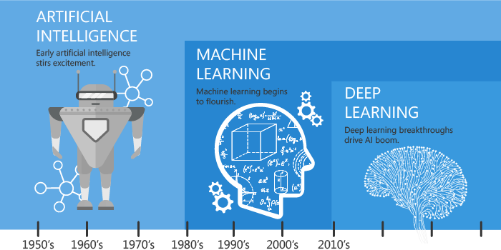
Certainly not new
Is AL / ML / DL New ?
01
Been there since 1950’s Pre- Robocop Days !!
Why all the hype now ?
02
There is more awareness, acceptance , explainability
Availability via Open Source tools
03
The public developer community has started contributing to the open source tools and they are widely available for use by all.
04
Data Availability , Storage and Compute
It is an entire ecosystem, with wider acceptance and usage, data storage and compute facilities, now available to all.
(AI VS ML VS DL-Let's Understand The Difference - Analytics Vidhya, 2022)

Slide 8
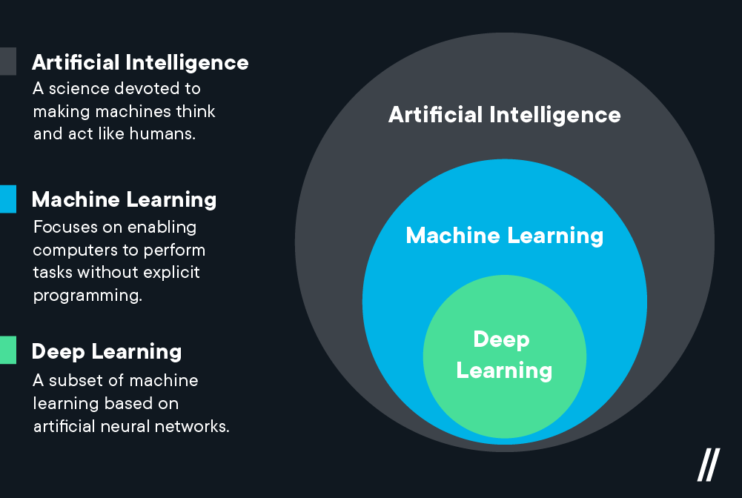
AI vs ML vs DL
Machine Learning (ML) is commonly used along with AI but it is a subset of AI. ML refers to an AI system that can self-learn based on the algorithm. Systems that get smarter and smarter over time without human intervention is ML. Deep Learning (DL) is a machine learning (ML) applied to large data sets.
Understanding the difference between AI, ML, and DL
https://content.techgig.com/technology/understanding-the-difference-between-ai-ml-and-dl/articleshow/75493798.cms
(Deep Learning vs. Machine Learning — What’s the Difference? | Flatiron School, 2022)
Notes:
IN AI : That science is devoted to making machine think and react as humans do
IN ML : a subset of AI that enables the machine to use Statistical models to learn from data.
IN DL : a subset of machine learning concerned with algorithms inspired by the structure of the function of the brain call ANN – Artificial Neural Network.

Slide 9
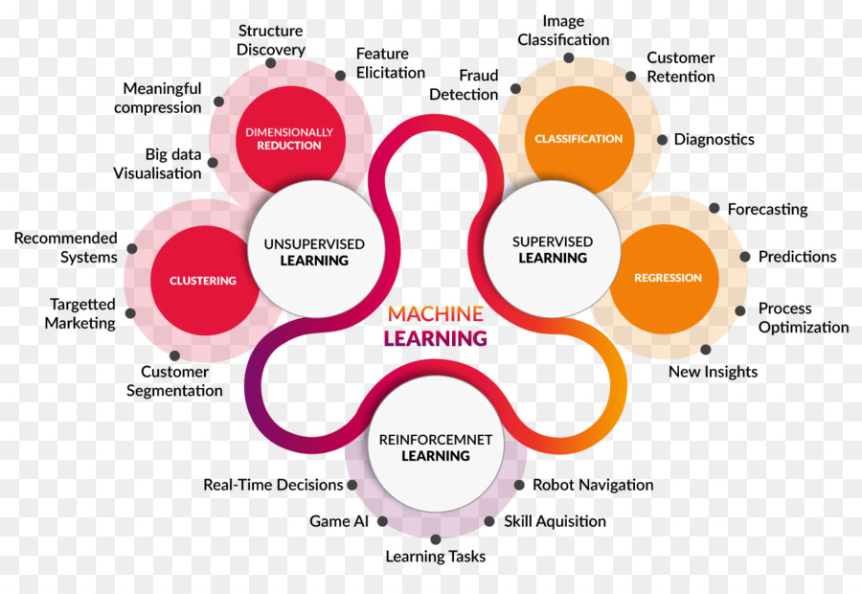
ML Embodiment
Within Supervised Learning – Time Series forecasting is a Statistical methodology
Time Series Prediction is another possible avenue with Big Data and DL
(AI VS ML VS DL-Let's Understand The Difference - Analytics Vidhya, 2022)

Slide 10
Market Data
Trade Surveillance and Monitoring
Use Cases

Slide 11
Spoofing / Layering
Front Running
Pattern of placing orders, cancelling them, and then placing new orders in the opposite direction.
proprietary orders happen in close proximity to a client order, impacting the share price
Insider Trading
Wash Trading
Tracking unusual trades in advance of the release of MNPI
Buying and selling in a brief time period, with no impact on the position or PNL
Market Abuse
Use Cases
(Nahum, 2022)
Marking the (open / close / fix )
Large trade /order placed during the last few seconds of trading, or an auction session
Notes:
Other types of Market Abuse include but not limited to the below:
Pump-and-dump use case. ...
Off-market use case. ...
Painting the tape,
Citi works with close to 40 behaviors
Spoofing and Layering :
Spoofing is a type of market manipulation where the participant tries to move the price of a financial instrument up or down by placing one large order, with no intention of executing it, to give the impression of market interest for that instrument.
Once the price has shifted, the original order is cancelled, and new orders are placed on the opposite side to take advantage of the favorable price movement created by the first order.
Front running;
an individual obtains knowledge about a lawful large order to buy or sell a financial instrument – by another individual or entity – which is going to hit the market at a particular time.
There is an assumption that such a large order will shift the price of the financial instrument. So, in front running, the individual makes a transaction, ahead of the lawful transaction, in the same direction, and then sometimes unwinds the position after the lawful
Insider Training :
Insider Trading occurs when an individual enters a trade because he or she has acquired material non-public information (MNPI) – positive or negative. Examples include advanced knowledge of earnings announcements, a change in the senior leadership team, or an M&A transaction.
The individual’s initial trades happen in advance of the public disclosure of the information – the individual will purchase instruments if he expects the price to rise as a result of the MNPI or sell/short if the news is negative. Once the MNPI is announced or becomes public through other means, such as through traditional or social media, the individual then closes his position to reap a profit.
Wash Trading :
trader wants to create artificial volume in a given security, so that it appears as though there is a “buzz” around it. So, he/she colludes with another trader, and together they buy and sell the security repeatedly and rapidly, in a manner that there is no change of ownership.
The trades have no economic purposes and are all executed at similar prices and similar quantities. The intention with Wash Trading is to increase the volume traded for an instrument, making it appear more liquid.
Marking the (Open / Close / FIX)
These behaviors involve deliberately buying or selling a security at the open, the close, or an intraday fixing period of the market to create an artificial price that is favorable to the trader.
Most banks use the closing price to value their portfolio of securities, and so by artificially inflating the price of the security through a marking the opening/close strategy, the PNL generated by a long position on the security will be increased.

Slide 12

What Next ?
Market Abuse - Use Case(s)
All behaviors that are to be surveilled and monitored
Data in relation to expected behaviours are analysed in accordance to, patterns and anomaly to be identified.
ML Usage of Pattern Recognition and
Time Series analysis
Market Data
The Citi Traded and Brokered data .
Notes:
We have a problem at hand …
And Data at hand.
We will next move into Identifying the appropriate ML models to identify the patterns and analyse the time series data.
Market Data being Timeseries Data, Let us Explore the different Time series models and how we can use them for prediction and forecasting. In relation to how we expect the market to move.
We can explore simple time series analysis with a view of how advanced volatility / price Predictions can be attempted in simple terms.

Slide 13
Market Data
Time Series Analysis

Slide 14
Appreciating Time-Series Family Tree
ARCH / GARCH /
EGARCH
SARIMA
SARMA
AR – Auto Regression
C – Conditional
H – Heteroscedasticity
ARIMA
S – Seasonal
AR – Auto Regression
I – Integrated
MA – Moving Average
ARMA
S – Seasonal
AR – Auto Regression
MA – Moving Average
G – Generalized
AR – Auto Regression
C – Conditional
H – Heteroscedasticity
AR – Auto Regression
I – Integrated
MA – Moving Average
AR – Auto Regression MA – Moving Average
E – Exponential
T – Threshold
…
..
.
Univariate vs MultiVariate – Indicated by (X) function
Exogenous variables vs Transfer f(n)
https://en.wikipedia.org/wiki/Autoregressive_conditional_heteroskedasticity#TGARCH_model

Slide 15
Familiarity on TimeSeries Analysis :
https://app.sli.do/event/3b2wmK88XECEJqhVNS48Ap

Slide 16
Basic Pre-Requisite Checks
Trends
To Identify Positive and Negative Trends
Seasonality
Showcases patterns that repeat at regular internals
Stationarity
Cyclicality
The distribution of the data doesn't change with time.
Is where there is a repeating pattern but no fixed period
1) The Trend Stationary has to be 0
2) Variance is constant
3) Auto-corellation is constant
White Noise
is a series of measurements where each value is uncorrelated with previous values
(LIKE AN OUTCOME ON A COIN FLIP, WHERE there is no relation from the previous flip to the current flip )

Slide 17
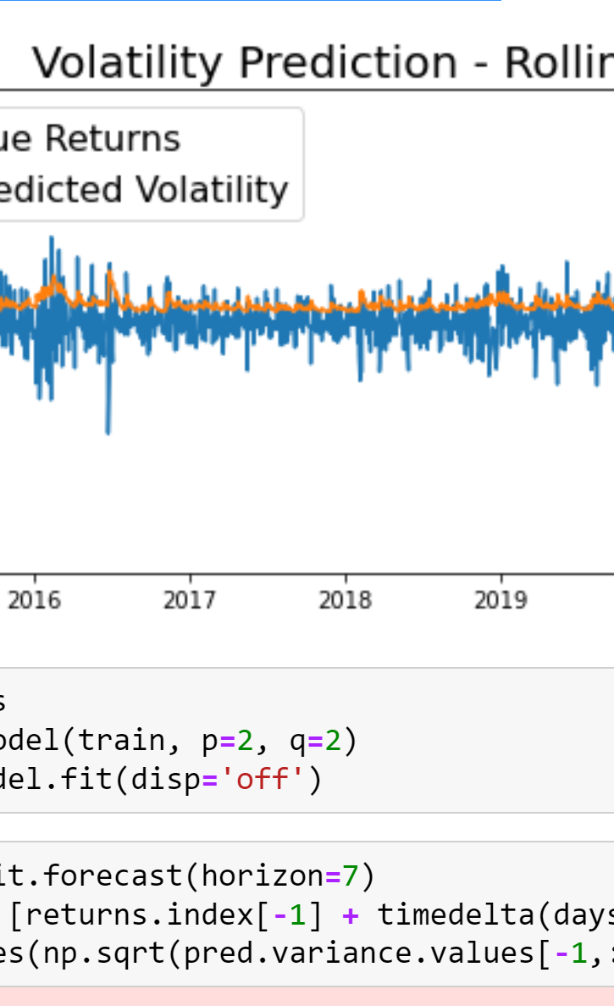
Python Demo
Understanding the Business Use Case
Understanding the data – and explore the Data Visually
Know when to use which model
Prepare the Data for modelling based on visual and statistical tests
Basic Stock Prediction on ARMA – SARIMA models
A view of how Volatility Predictions work
Transforming the Data back
into Business related KPI

Slide 18
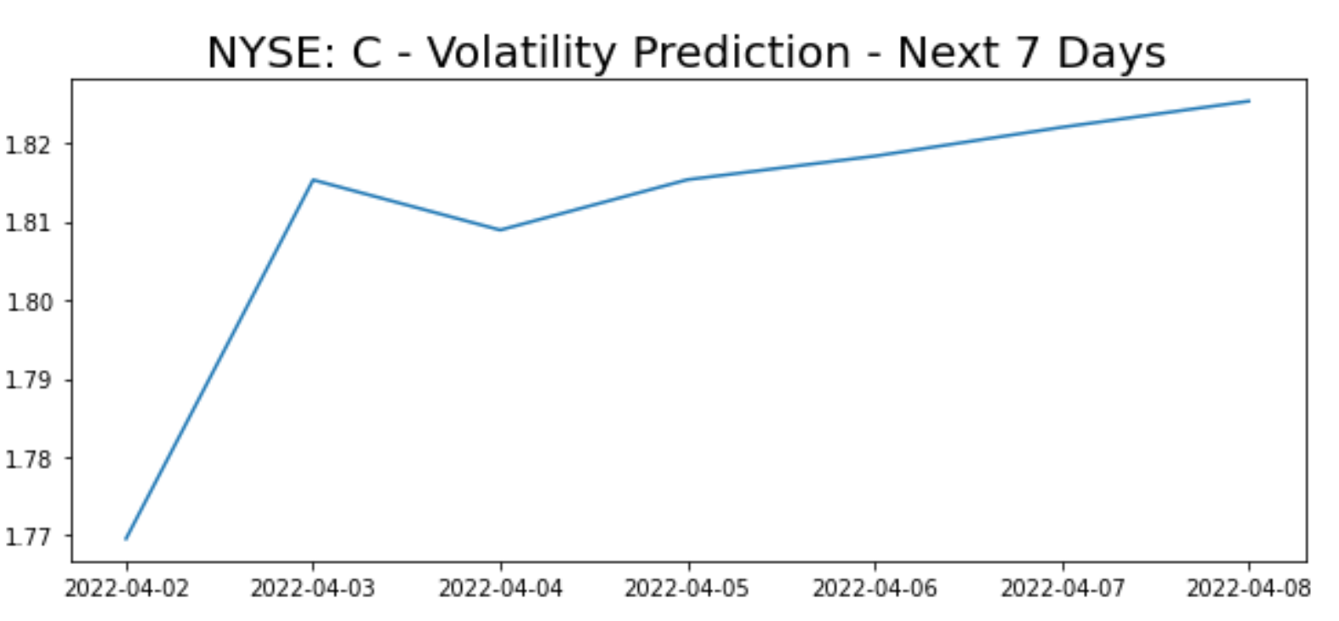
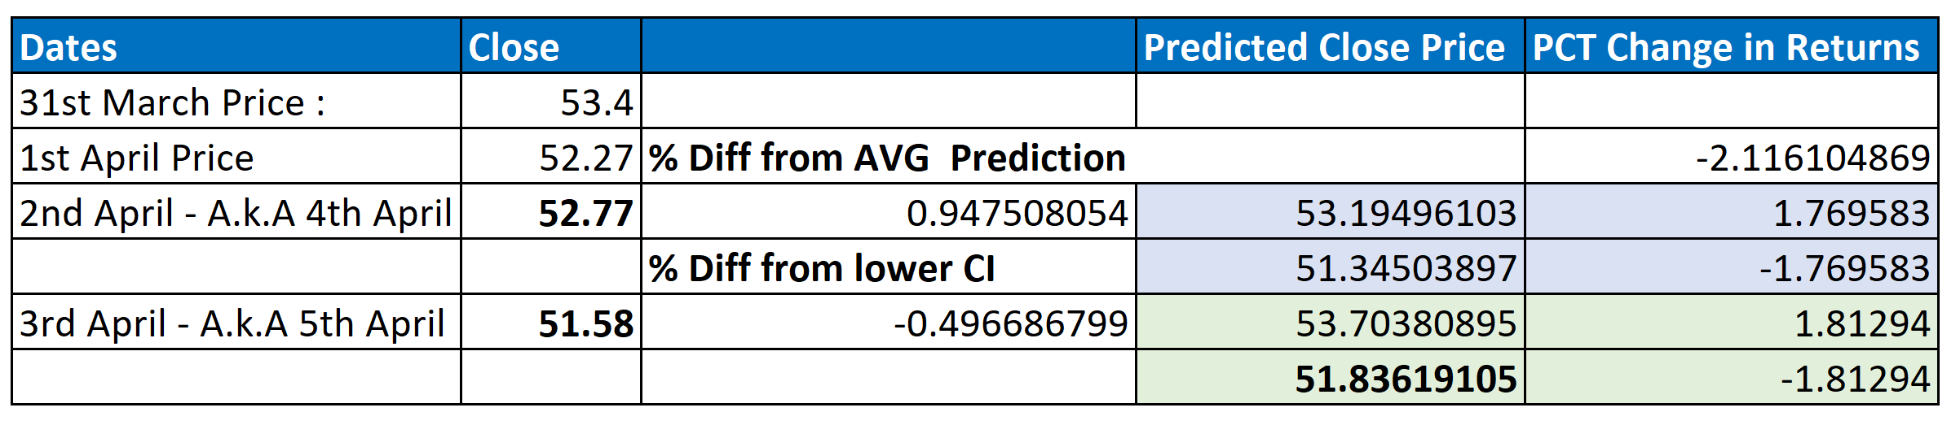
Checking on Forecast

Slide 19
Market Data
Olympus as a Data Fabric

Slide 20
3 items that caught your attention today :
https://app.sli.do/event/3b2wmK88XECEJqhVNS48Ap

Slide 21

1010011010010000101010011110111011011011010101000011100101011001010100111010100010101
THANK YOU
W@CWC / Sweta the host
for today
All you wonderful audience
https://github.com/theivanai05/W-CWC-TimeSeries-Session
https://www.linkedin.com/in/theiv/

Slide 22
Additional Once :
Market Abuse Use Case:
Nahum, B., 2022. 5 Prominent Market Abuse Behaviors and How To Spot Them. [online] Steel-eye.com. Available at: <https://www.steel-eye.com/news/five-prominent-market-abuse-behaviours-and-how-to-spot-them> [Accessed 26 March 2022].
YouTube TimeSeries Channel :
https://github.com/ritvikmath/Time-Series-Analysis
There are many more Research Papers , documentation and Models and Youtube sessions that you can access to learn more on this topic.
Bibliography

